Slide 1

Overview of the Hboot Architecture
Albert.zl Huang

Slide 2

Outline
HbootII Architecture
What is fastboot?
HTC zipped ROM ‘s Android.info
Security Policy

Slide 3
HbootII Architecture
Build Hboot
  Toolchain: arm-eabi-4.2.1
  $make ste6715
  $./makeImages.sh
  Output: out/android.swbootloader

Slide 4
HbootII Architecture
Hboot is responsible for
  Manufactory testing
  Update HTC ROM Images
    SD Card
    Fastboot by using USB
    FOTA Firmware update
  Check the Boot Reason
    Normal
    RTC Alarm trigger
    Recovery mode
    Reboot testing
    …
  Commands for Engineer Debug
    hboot> ram_test
    hboot> Flash_test
  Load and Execute system boot images

Slide 5
HbootII Architecture
Diagnostics is MFG test program
Diagnostics is built by Hboot codes
0x3000 0000
HBOOT
0x23F2 0000
Jump and execute between each others
0x2070 0000
diagnostics
0x2000 0000
SDRAM

Slide 6
HbootII Architecture
Fastboot
  For Engineer
SD Card
  For Factory or Customer
RUU
  For SQA or Customer
FOTA firmware
  End user

Slide 7
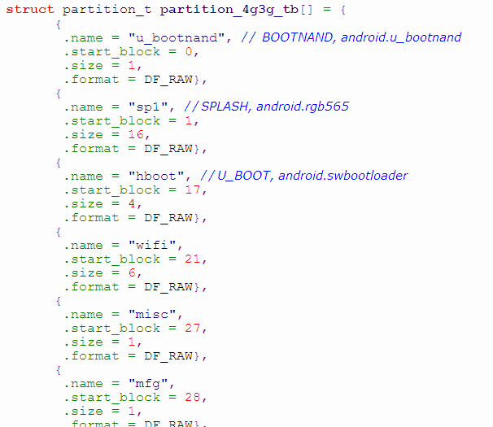
HbootII Architecture
BBM Area
0x1F540000
data
spcustom
cache
system
local
rootfs / recoveryfs
modemfs
ramdump
radio
boot
mfg2
misc2
mfg
misc
wifi
swbootloader (exe)
splash (raw image)
bootnand + PTT
0x00000000

Slide 8
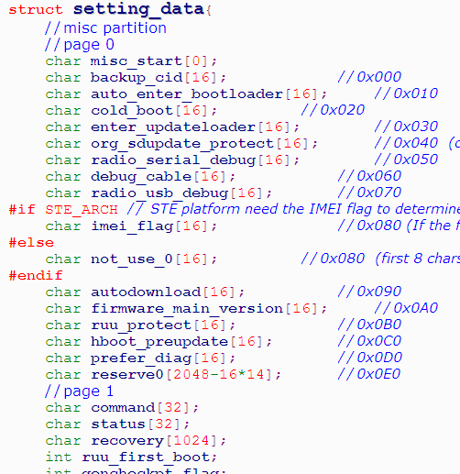
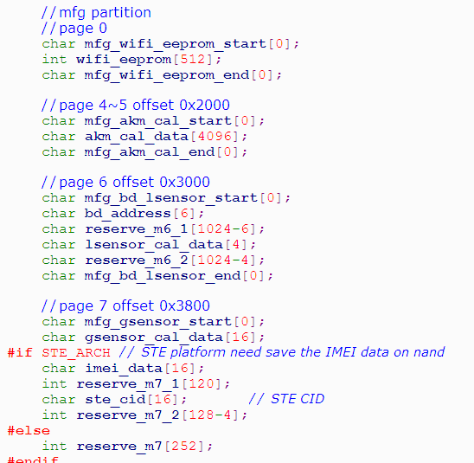

HbootII Architecture
Setting_init()
  Copy from misc/mfg partitions
We should release corresponding nand usage doc for MFG member implement Diag program

Slide 9
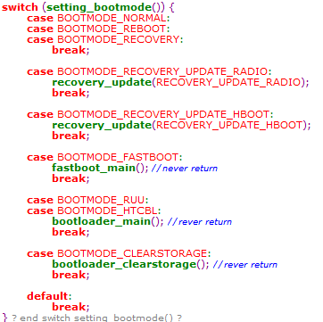
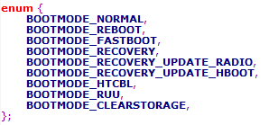
HbootII Architecture
Boot Mode
  recovery_update
    Fota update
  fastboot_main
    Fastboot download
    Fastboot cmd
  bootloader_main
    SD download
    Hboot cmd
  power test
    fatory sleep current test

Slide 10
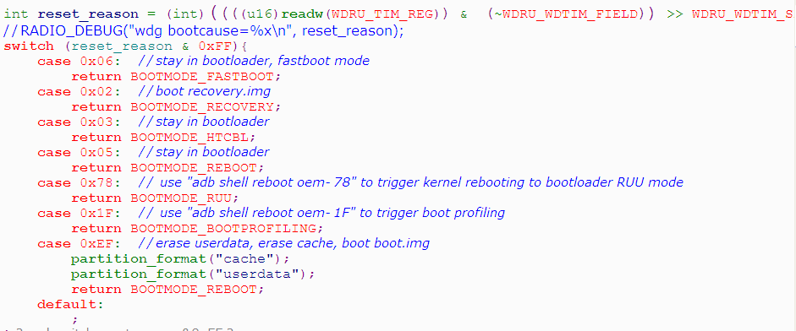
HbootII Architecture
Using Watch Dog Register to determine the boot reason

Slide 11
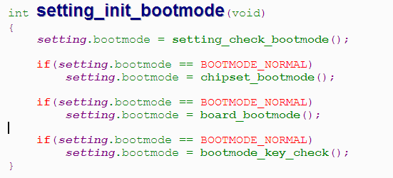
HbootII Architecture
Boot reason from
  misc partition
  Chipset Watch Dog Register
  Combo Key press
    Power + Volumn Up -> Fastboot mode
    Power + Volumn Down -> Bootloader mode

Slide 12
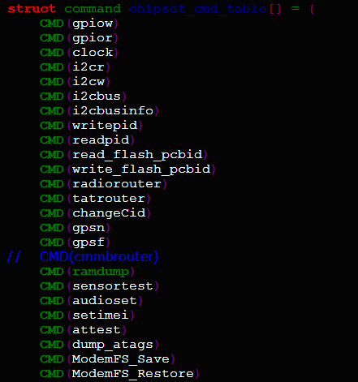
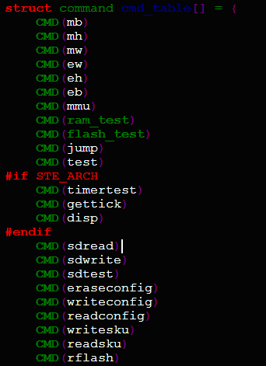
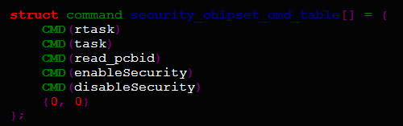
HbootII Architecture
Hboot cmd lists
Please refer to chipset_cmd.c, command.c,
Bootloader.c, etc.

Slide 13
HbootII Architecture
HBoot:
platform setup
  1st splash screen
  boot system (relay on PTT)
  (virt/Modem/linux)
SW boot stage
splash
swbootloader
(4) jump
(1) load
vmlinux
vmlinux
SCROM
radio
SDRAM
(2) load
radio
bootnand
atag list
(3) Fill atags
swbootloader
SCRAM
Nand
System
go((u32)0, linux_type, linux_tags, (u32)0);

Slide 14
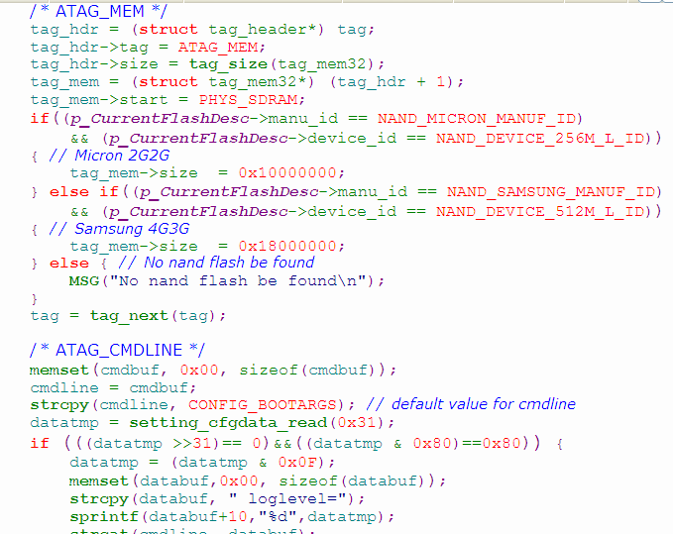
HbootII Architecture
[boot.c] machine_id(2785), tags_addr(0x1E800), kernel_addr(0x20000000)

Slide 15
What is fastboot?
Fastboot is protocol used to update the flash filesystem in Android devices from a host over USB
fastboot getvar [parameter]
fastboot flash zip [Zipped ROM]
fastboot flash [image name] [source image]
For example
# fastboot flash boot boot.img
# fastboot flash radio radio.img

Slide 16
What is fastboot?
fastboot getvar [parameter]
Parameters
  "version": fastboot version
  “version-bootloader”: bootloader version
  “version-baseband”: radio version
  “version-cpld”: cpld version
  “version-microp”: microp version
  “version-main” or ”mainver”: main version of ROM image
  “serialno”: serial number of the device
  “product”: board name
  “platform”: chipset platform name
  “mid” or ”modelid”: model ID
  “cid” or ”cidnum”: custom ID

Slide 17
What is fastboot?
Parameters (conti.)
  “battery-status": battery status for flashing image safely
  “battery-voltage": battery voltage while device bootup
  “partition-layout": [HTC] means the system/cache partition is increased to 80MB on Sapphire
  “security”: security status for checking signature or not while updating image
  “build-mode”: build-mode of bootloader. [MFG], [ENG], [SHIP]
  “boot-mode”: current bootloader mode. [FASTBOOT], [RUU]
  “commitno-bootloader”: commit No. of source codes on Git server
  “version-tp”: touch panel firmware version
  “hbootpreupdate”: No. of Hboot pre-update policy

Slide 18
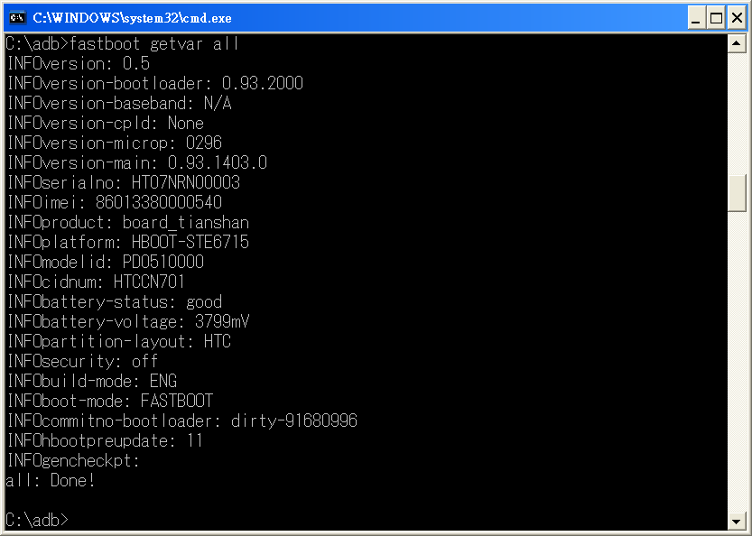
What is fastboot?
$ fastboot getvar all

Slide 19
HTC zipped ROM ‘s Android.info
modelid: PC63*****
  The first 4 characters of “modelid” is the header of the project name, and it must be upper case.
cidnum: HTCCN701
  It means the custom ID which the device must have.
  if your device has the super cid, i.e., all eight characters of the custom ID on your device are the same, means nothing.
mainver: 0.95.1403.3
  It means the main version of this image.
  HbootII Version should be 0.95
  1403 is the SKU number (relay on AA build server)
deletecache:1
  erase the cache partition always

Slide 20
HTC zipped ROM ‘s Android.info
hbootpreupdate: 0 => Force the Hboot pre-update mechanism to be NOT functional
hbootpreupdate: 1 => pre-updating Hboot while the version of Hboot in the zipped image is newer than that of the current device
hbootpreupdate: 2 => pre-updating Hboot while the version of Hboot in the zipped image is different from that of the current device
hbootpreupdate: 3 => Force Hboot to be pre-updated
hbootpreupdate: 11 or Non-define => pre-updating Hboot and Radio simultaneously while the version of Hboot in the zipped image is newer than that of the current device
hbootpreupdate: 12 => pre-updating Hboot and Radio simultaneously while the version of Hboot in the zipped image is different from that of the current device
hbootpreupdate: 13 => Force Hboot and Radio to be pre-updated simultaneously

Slide 21
HTC zipped ROM ‘s Android.info
Take Tianshan as an example
ModelID: PD05*****
ModelID: TIAN*****
CIDNUM: HTCCN701
CIDNUM: DOPOD701
HbootPreUpdate: 11
delcache:1
MainVer: 0.95.1403.3

Slide 22
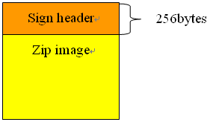
Security Policy
Objective:
  Make sure shipping device can only re-flash HTC formal released ROM code.
All projects have themselves sign key matrix.
Not allow to update self OTA
Not UART in H/W, but
You can still use some SHIP commands by
Using fastboot.
# fastboot oem xxxx
# fastboot oem enableSecurity
# fastboot oem disableSecurity

Slide 23
Security Policy
Use key card to control Check MID, CID HTC ROM images flashing.
There are three security levels which is 0, 1 2.
Given from security library by CertificateSecurityDataArea function call in hbootII.
hboot> checkKeyCard
Get g_cKeyCardSecurityLevel=[0]

Slide 24
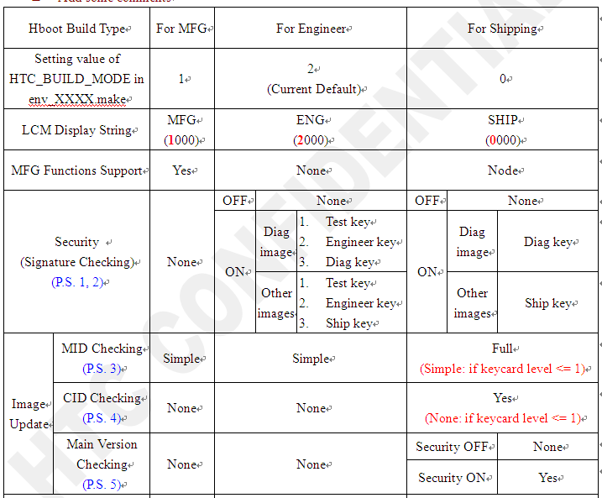
Security Policy

Slide 25
Security Policy
SD Update
Fastboot Update
is_signature_okay
GetKeyCardSecurityLevel from SD Card
CheckModelID
If security level <= 1
Yes
No
CheckCID
CheckMainVer

Slide 26
Q&A

